Slide 1
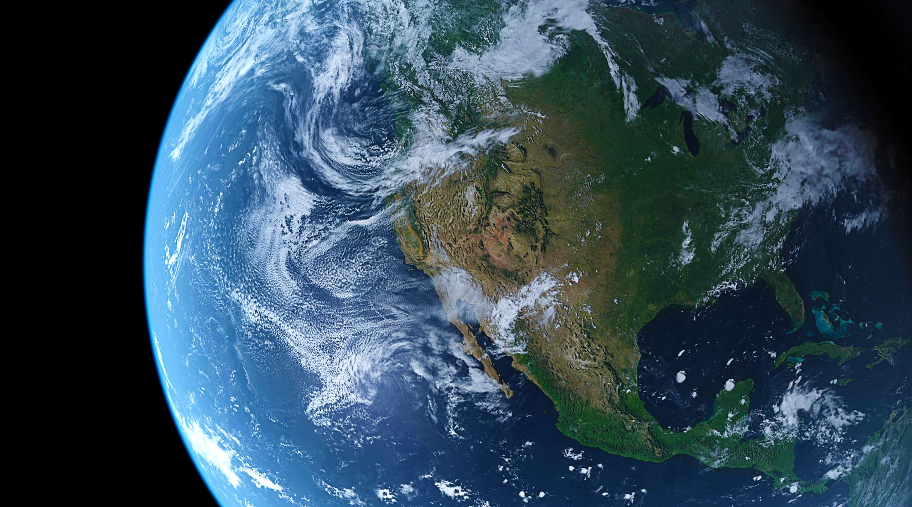
My top 5 Islands
Saidjon Nozimboev
110186060

Slide 2
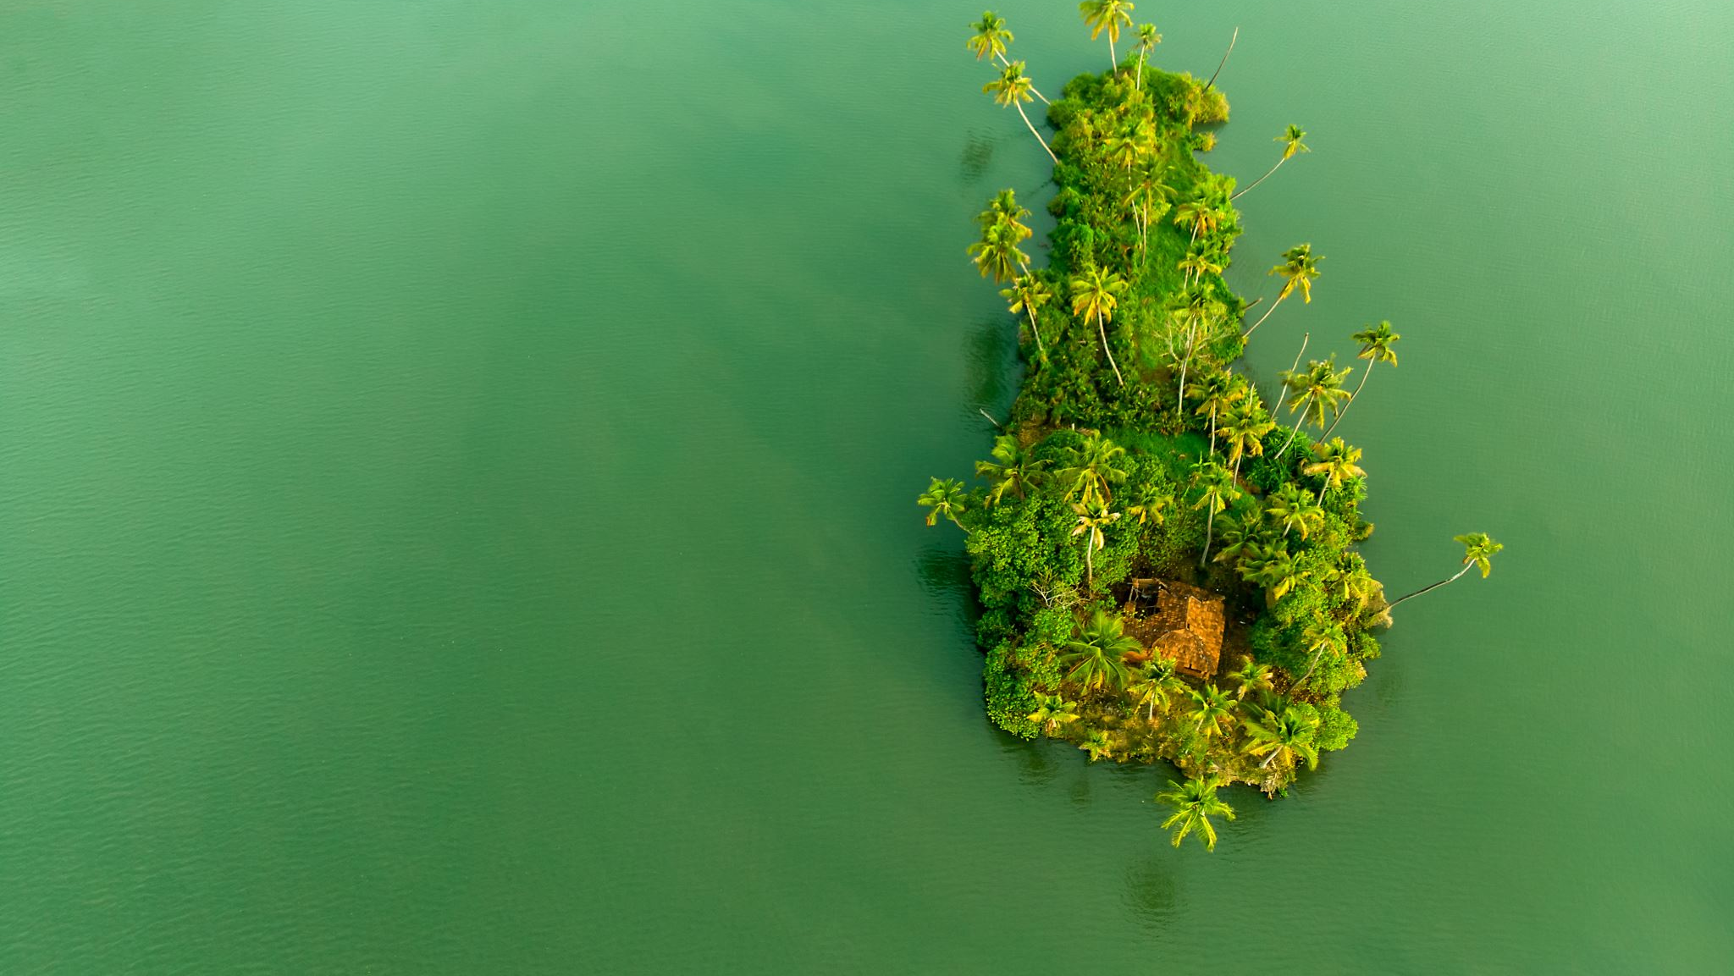
1. Sentosa Island, Singapore 2. Socotra Island, Yemen 3. Ilha da Queimada Grande, Brazil 4. Tristan da Cunha, UK 5. Bali, Indonesia

Slide 3
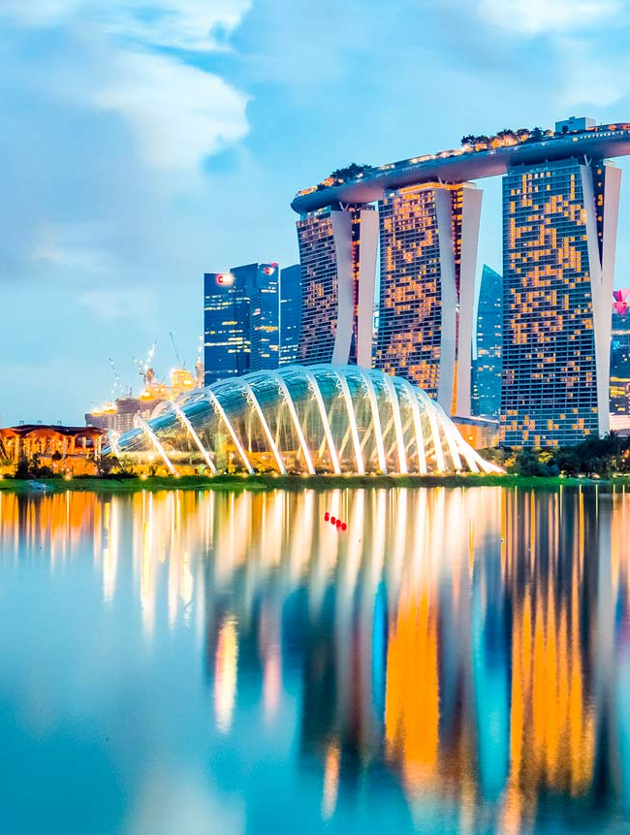
Fun Fact about Sentos Island
Sentosa Island's name means "peace and tranquility" in Malay, but before that, it was actually called Pulau Blakang Mati, which translates to "Island of Death from Behind"

Slide 4
I want to visit Sentosa Island because it is one of the most ultra-developed islands in the world, offering world-class attractions, luxury resorts, and exciting entertainment.
I believe I will be able to visit Sentosa Island in the next 5 to 6 years, once I have the time and resources to experience this amazing destination.

Slide 5
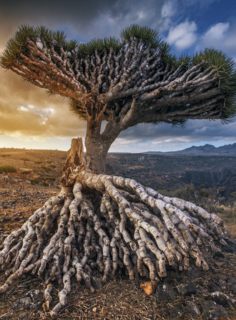
Fun Fact about Socotra Island
Socotra is home to the dragon’s blood tree, which looks like an upside-down umbrella and produces red sap that was once believed to be the blood of dragons

Slide 6
I want to visit Socotra Island because it is one of the most natural islands in the world, with unique plants and landscapes that look like they belong on another planet
I think I will most likely be able to visit Socotra Island in the next 7 to 8 years, as it requires special travel arrangements and is not a typical tourist destination.

Slide 7
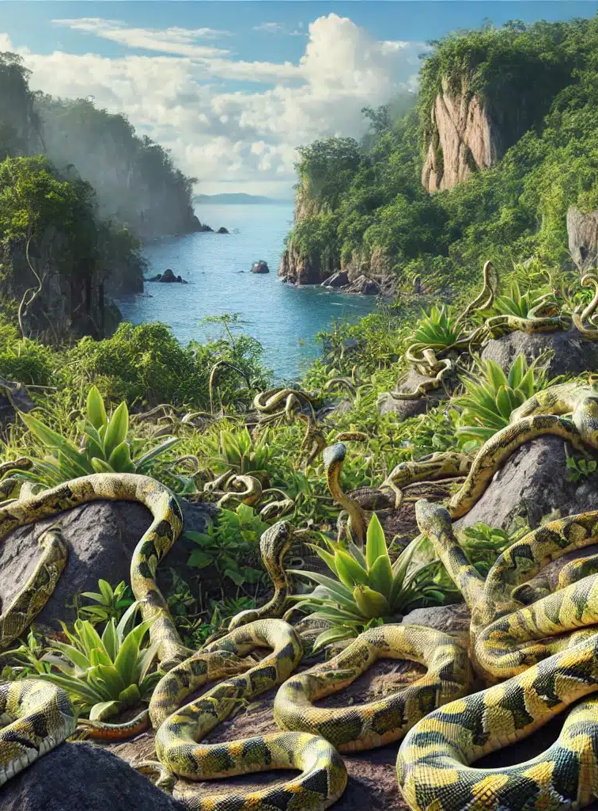
Fun Fact about Ilha da Queimada Grande
There are so many snakes on this island that it’s estimated you’re never more than a few feet away from one at any time!

Slide 8
I want to visit Snake Island because it is one of the most dangerous islands in the world, filled with thousands of venomous golden lancehead vipers. It would be a thrilling (and terrifying) adventure
Honestly, probably never, since it is illegal to visit without special permission. But if I ever get a chance, it would be in 10+ years, once I’m ready for extreme adventure!

Slide 9
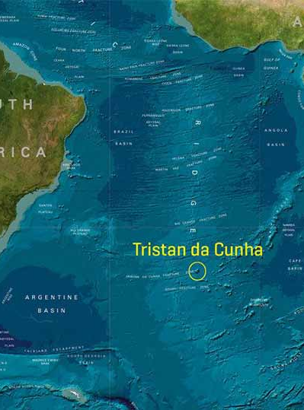
Fun Fact about Tristan da Cunha
Tristan da Cunha has only one shop, which opens only three days a week! So if you forget to buy something, you’re out of luck for a while ☺

Slide 10
I want to visit Tristan da Cunha because it is the most remote island in the world, with a small, tight-knit community and beautiful volcanic landscapes.
I think I will most likely be able to visit Socotra Island in the next 7 to 8 years, as it requires special travel arrangements and is not a typical tourist destination.

Slide 11
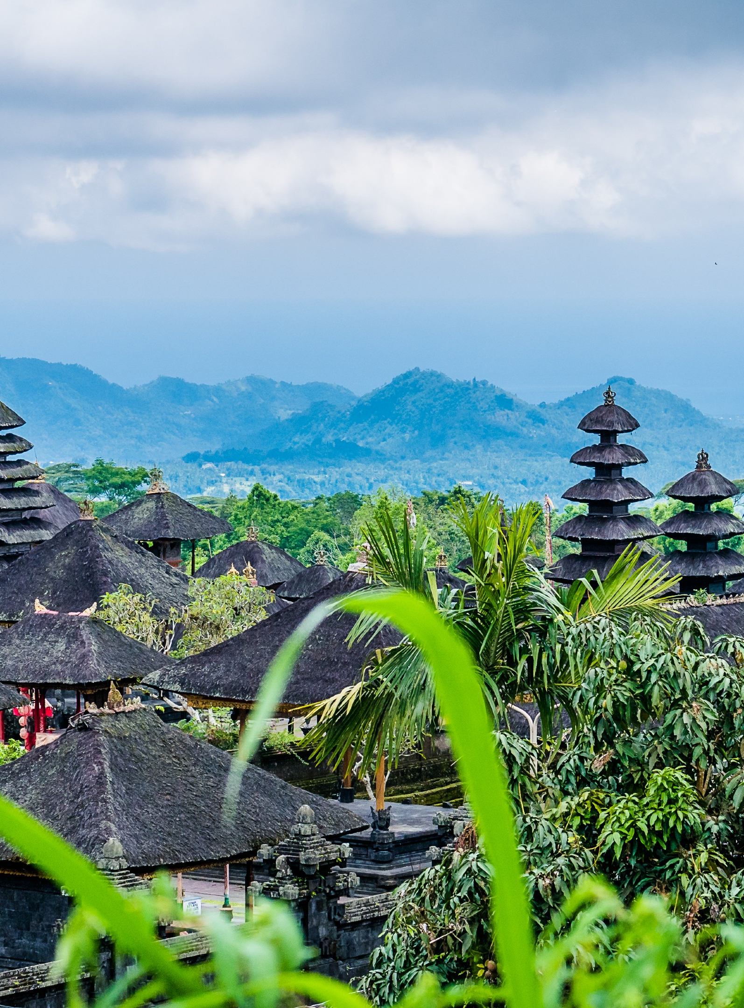
Fun Fact about Bali
Bali has more temples than houses! There are around 20,000 temples on the island, so you’re never too far from a sacred spot.

Slide 12
I want to visit Bali because it is one of the most affordable islands for students, offering beautiful beaches, rich culture, and budget-friendly accommodations.
I think I will most likely be able to visit Bali in the next 3 to 4 years, since it is a very student-friendly destination and doesn’t require a huge budget.

Slide 13
The world is full of unique and fascinating islands, each offering something special. In this presentation, I explored five extraordinary islands based on different characteristics:
Sentosa Island, Singapore – A highly developed island with world-class attractions and entertainment.
Socotra Island, Yemen – A breathtaking natural wonder with rare plant species and untouched landscapes.
Ilha da Queimada Grande, Brazil – One of the most dangerous islands, home to deadly snakes.
Tristan da Cunha, UK – The most remote inhabited island, located in the middle of the South Atlantic Ocean.
Bali, Indonesia – A budget-friendly paradise, perfect for students looking for an affordable getaway.
These islands showcase the diversity of destinations worldwide, from modern cities to untouched wilderness, from dangerous terrains to remote havens, and from luxury to affordability. No matter what type of adventure you seek, there’s an island for everyone!

Slide 14
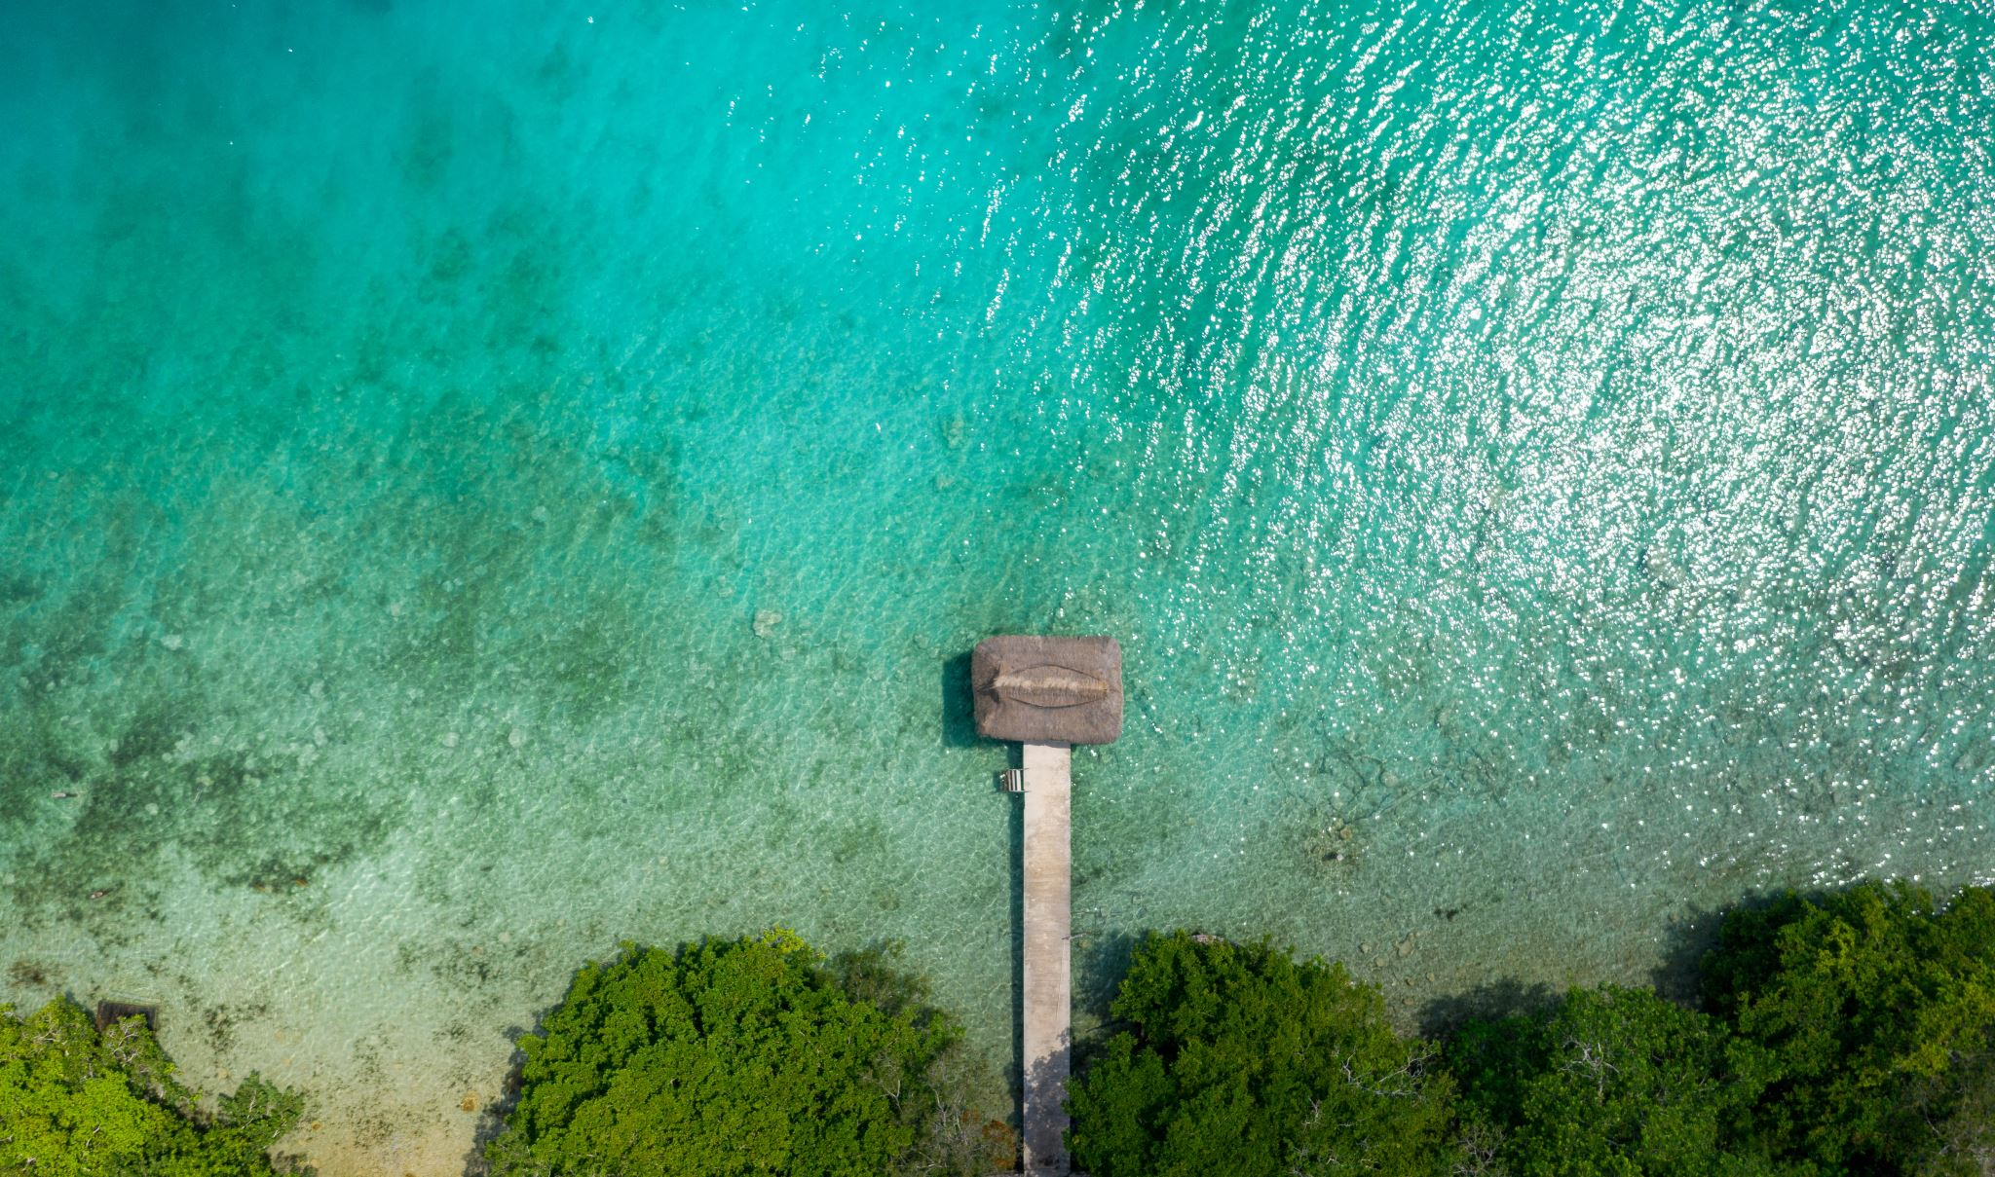
Thank You! Thank you for your time and attention. I hope you enjoyed learning about my top 5 island destinations!

